Slide 1
Village Economic Growth Intelligence

Slide 2
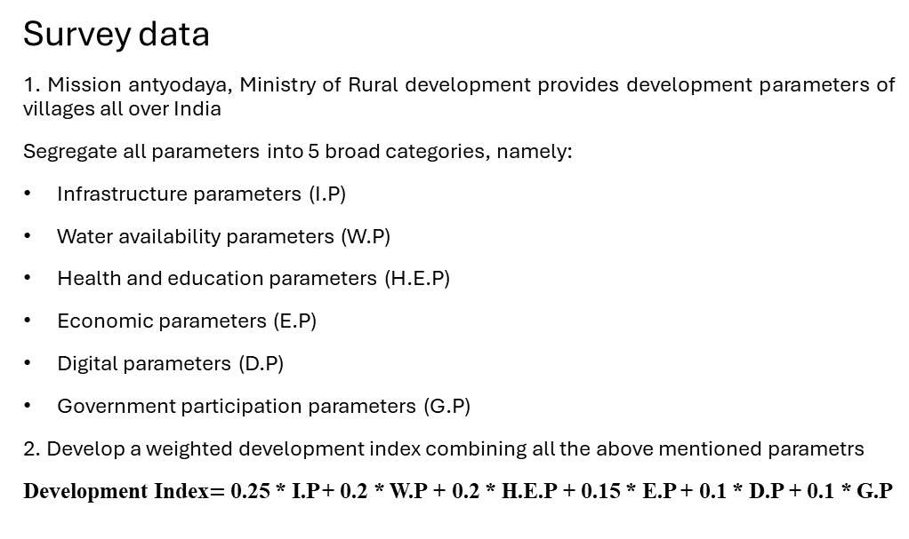
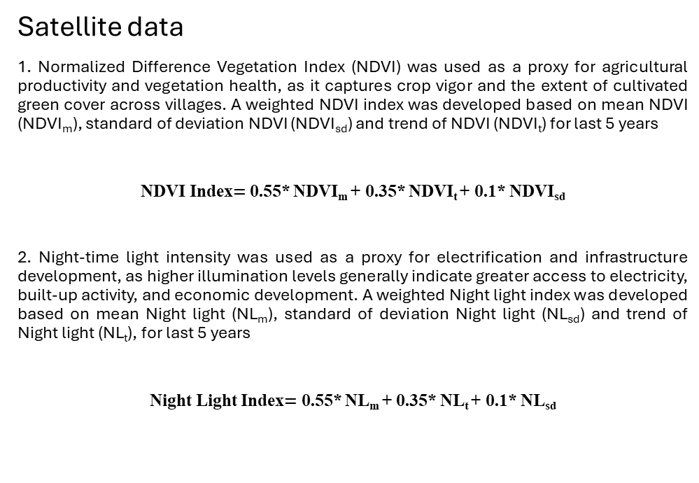
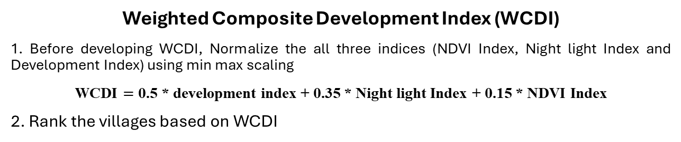
Methodology
Satellite data
1. Normalized Difference Vegetation Index (NDVI) was used as a proxy for agricultural productivity and vegetation health, as it captures crop vigor and the extent of cultivated green cover across villages. A weighted NDVI index was developed based on mean NDVI (NDVI_{m}), standard of deviation NDVI (NDVI_{sd}) and trend of NDVI (NDVI_{t}) for last 5 years
NDVI Index$=$ 0.55* NDVI_{m} + 0.35* NDVI_{t} + 0.1* NDVI_{sd}
2. Night-time light intensity was used as a proxy for electrification and infrastructure development, as higher illumination levels generally indicate greater access to electricity, built-up activity, and economic development. A weighted Night light index was developed based on mean Night light (NL_{m}), standard of deviation Night light (NL_{sd}) and trend of Night light (NL_{t}), for last 5 years
Night Light Index$=$ 0.55* NL_{m} + 0.35* NL_{t} + 0.1* NL_{sd}
Survey data
1. Mission antyodaya, Ministry of Rural development provides development parameters of villages all over India
Segregate all parameters into 5 broad categories, namely:
Infrastructure parameters (I.P)
Water availability parameters (W.P)
Health and education parameters (H.E.P)
Economic parameters (E.P)
Digital parameters (D.P)
Government participation parameters (G.P)
2. Develop a weighted development index combining all the above mentioned parametrs
Development Index$=$ 0.25 * I.P + 0.2 * W.P + 0.2 * H.E.P + 0.15 * E.P + 0.1 * D.P + 0.1 * G.P
Weighted Composite Development Index (WCDI)
1. Before developing WCDI, Normalize the all three indices (NDVI Index, Night light Index and Development Index) using min max scaling
WCDI $=$ 0.5 * development index + 0.35 * Night light Index + 0.15 * NDVI Index
2. Rank the villages based on WCDI

Slide 3
Methodology
Extract mean annual NDVI of each village from 2021 to 2025
(Proxy for agriculture area)
Extract mean annual Night lights (NL) of each village from 2021 to 2025
(Proxy for electrification of villages)
Extract mission antyodaya dataset which provides welfare parameters at village level
Data extraction and Transformation
Compute weighted NDVI Index for each village based on mean NDVI, S.D NDVI and trend of NDVI
Compute weighted NL Index for each village based on mean NL, S.D NL and trend of NL
Compute weighted development index based on the development parameters given in mission antyodaya dataset
Data analysis
Develop a Weighjted Composite development index combining satellite and survey data

Slide 4
Data sources
Village boundary shapefile : National water data portal, Government of India (link)
MODIS NDVI data : Google earth engine data catalog (link)
Night light data : Google earth engine data catalog (link)
Mission Antyodaya survey dataset : Ministry of Rural development (link)

Slide 5
Findings
The top-ranked villages are concentrated in southern and western India, with Tamil Nadu (48 villages) and Gujarat (44 villages) contributing the largest share of the top 100, followed by Karnataka (27).
Both NDVI and Night light intensity in top 100 villages show a weak positive correlation with the composite development index, with nightlights (r = 0.12) exhibiting a slightly stronger relationship than NDVI (r = 0.06), suggesting that while satellite indicators provide useful contextual information, village development is driven more strongly by socio-economic and infrastructure variables than by remote sensing indicators alone
Tamil Nadu shows the highest number of elected women representatives among the top-ranked villages (183), significantly higher than all other states, followed by Gujarat and Madhya Pradesh. This indicates comparatively stronger women’s representation in local governance within high-development villages, particularly in Tamil Nadu, highlighting the role of inclusive governance as a potential contributor to village development
Among the top 100 villages, Tamil Nadu has the highest number of primary schools with computer labs (70), followed by Gujarat (25) and Karnataka (22). This suggests stronger digital education infrastructure in these states, which likely contributes to higher village development scores through improved access to technology-enabled learning and educational resources
Among the top 100 villages, Tamil Nadu, Gujarat, and Karnataka show the highest cumulative distance to the nearest empaneled hospital. This likely reflects both their higher representation in the top-ranked village list and geographic variation in healthcare access, suggesting that strong overall village development can coexist with varying levels of proximity to secondary healthcare facilities

Slide 6
Limitations
Village level boundary shapefiles provided by Government of India consists of lot of geometric errors
Use of NDVI as a proxy for agricultural activity poses a risk of including seasonal vegetation patterns
When analyzing spatial data at village level, it requires a huge computational resources
The mission Antyodaya data consists of lot errors and the coordinates provided also fall outside Indian boundary
There is a mismatch between the village shapefile provided by National water data portal and Mission antyodaya survey data
Mission Antyodaya survey does not provide development parameters for all villages of all states completely

Slide 7
Improvements
Use of building footprints per village to show pukka house development
Use of Open street map dataset to find length of roads, amenities and other parameters at village level
Mission Antyodaya provides more than 300 parameters which are not completely used in this study
Development indices for each village should take its area into account. (Right now, large villages may be interpreted as developed villages due to more number of pixel aggregation in the village boundary)

